Slide 1
Understanding your PSAT/NMSQT scores

Slide 2
Objectives for today
Understand your PSAT/NMSQT scores and how it can benefit you in the future with the SAT, AP course selection, and scholarships
Create an online College Board account
Learn how you can link your scores to online test prep through Khan Academy
Learn about the College Board Opportunity Scholarships

Slide 3
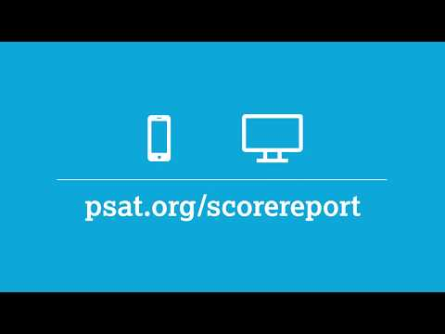
Understanding Your Score Report

Slide 4
Score Report- Page 1
College Readiness Benchmarks You’ll see a benchmark for each section of the PSAT/NMSQT and PSAT 10. Benchmarks are the scores that represent college readiness. In other words, if you score at or above the benchmark, you’re on track to be ready for college when you graduate high school. If you score below the benchmark, you still have time to work on your skills. Use the detailed feedback in your online score report to see which skills need the most improvement.
Percentile Ranks A percentile rank is a number between 1 and 99 that shows how you scored compared to other students. It represents the percentage of students whose scores fall at or below your score. For example, a 10th-grade student in the 57th percentile scored higher than or equal to 57 percent of 10th-graders. You’ll see two percentiles:
The Nationally Representative Sample percentile compares your score to the scores of typical U.S. students in a particular grade.
The User Percentile compares your score to the scores of actual College Board test-takers in a particular grade.

Slide 5
Score Report- Page 2
JUNIORS who qualify for national merit scholarship should visit www.nationalmerit.org
AP Potential is a tool that informs you which AP courses you may want to consider for their future schedule, due to being likely to score a 3 or higher on the exam, given their performance on the PSAT (you will explore this further when you log in online)

Slide 6
Score Report- Page 3
“See the question by question answers to learn the areas of strength and areas of weakness. This will help you know what to focus on for practicing for the SAT and/or the 11th grade PSAT.”

Slide 7
Why create an account?
With a College Board account, you can access your SAT and AP scores online, and send them to colleges. You can also register for the SAT exam, and print your SAT Admission Ticket. Additionally, an account lets you manage your personal college list, save your scholarship searches, compare costs at colleges that interest you, and more.

Slide 8
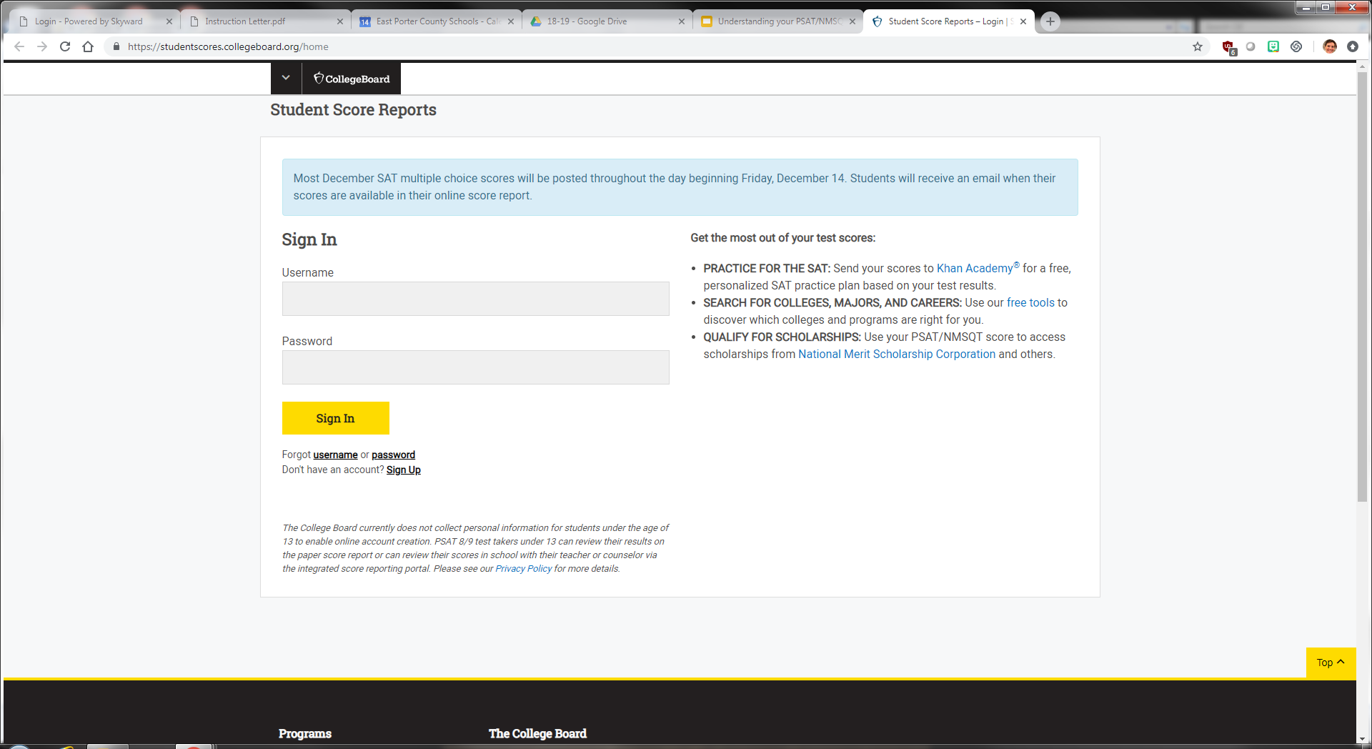
Creating your account and accessing your online score report
Log onto studentscores.collegeboard.org
Create a College Board account, if you haven’t already

Slide 9
After you’ve created an account...
Click on the View Details button and explore the Report Details tab to dig deeper into their scores and AP potential course suggestions.
2. Explore the Skills Insight tab and see more about how to
improve scores.

Slide 10
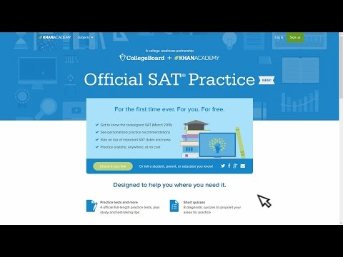
Linking Your Account to Khan Academy- Test Prep

Slide 11
College Board Opportunity Scholarships

Slide 12
Juniors- registering for the SAT
Go to https://collegereadiness.collegeboard.org/sat/register?excmpid=VT-00053

